Slide 1

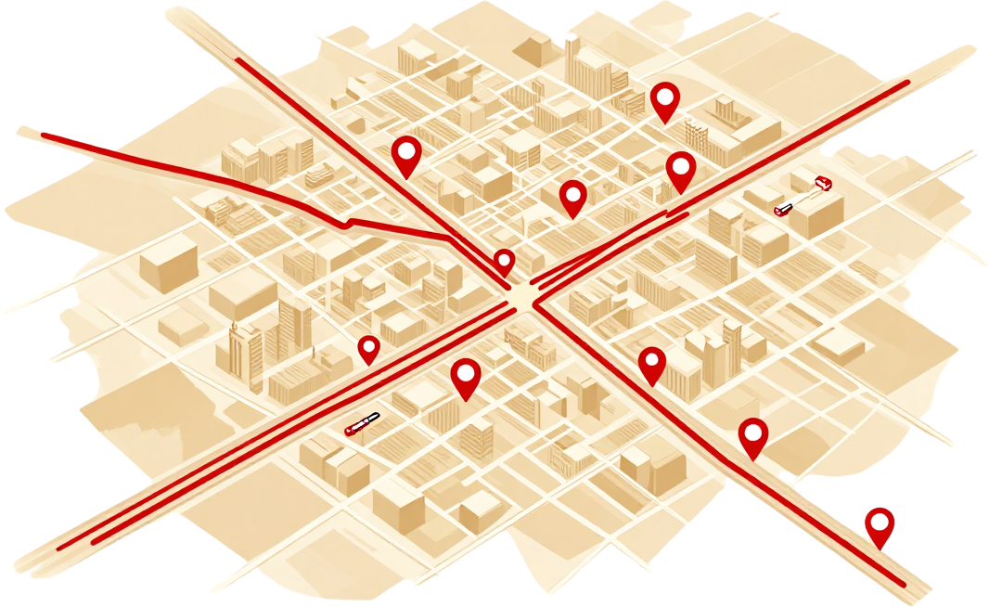

TECHNICAL REPORT
SMART AMBULANCE
ROUTE SELECTION
PRESENTED BY TEAM 9 :
-KUSUMA
-AKSHAYA
-KEERTHANA
-A.MAHESH

Slide 2

ABSTRACT & INTRODUCTION
India faces a critical emergency response gap — with over 1.5 lakh road accidents and millions of medical emergencies annually, delayed ambulance dispatch costs lives. This project proposes an intelligent system to select the optimal ambulance and route for each emergency request by evaluating four key parameters: patient severity, GPS-based distance, real-time traffic conditions, and live ambulance availability.
Using priority-based algorithms and mapping APIs tailored to Indian road networks, the system ensures the nearest, most suitable ambulance reaches the patient via the fastest available route. The solution is designed for Indian cities where traffic congestion, narrow lanes, and high call volumes challenge traditional dispatch methods — enabling faster response, better resource utilisation, and ultimately, saving more lives.

Slide 3


PROBLEM STATEMENT & OBJECTIVES
Problem: Delayed ambulance dispatch and inefficient routing in Indian cities leads to preventable fatalities. Current systems lack real-time integration of severity triage, traffic conditions, and ambulance availability.
Objectives:
• Prioritize emergencies by medical severity level
• Minimize ambulance travel time using optimal routing
• Integrate real-time traffic and road network data
• Monitor ambulance fleet availability dynamically
Scope: Indian urban and semi-urban road networks including cities such as Mumbai, Delhi, Bengaluru, and Chennai, leveraging local map APIs and traffic data sources.

Slide 4



FEATURES & FUNCTIONAL REQUIREMENTS
Emergency Request Intake: Captures patient location via GPS on Indian road networks (NH, SH, city roads). Severity Classification: AUTO-triages calls as Critical, Urgent, or Stable using symptom data. Ambulance Tracking: Real-time vehicle tracking on Indian city maps (Delhi, Mumbai, Bengaluru grids). Availability Checker: Monitors ALS/BLS unit status, crew readiness & equipment. Route Selection: Selects fastest route via OSRM/Google Maps India API with traffic & signal data. Traffic-Aware ETA: Calculates dynamic ETA using live congestion on Indian arterial roads. Hospital Mapping: Nearest NABH-accredited hospitals displayed with bed availability. Dispatcher Alerts: Instant push notifications & dashboard alerts to control room operators.

Slide 5
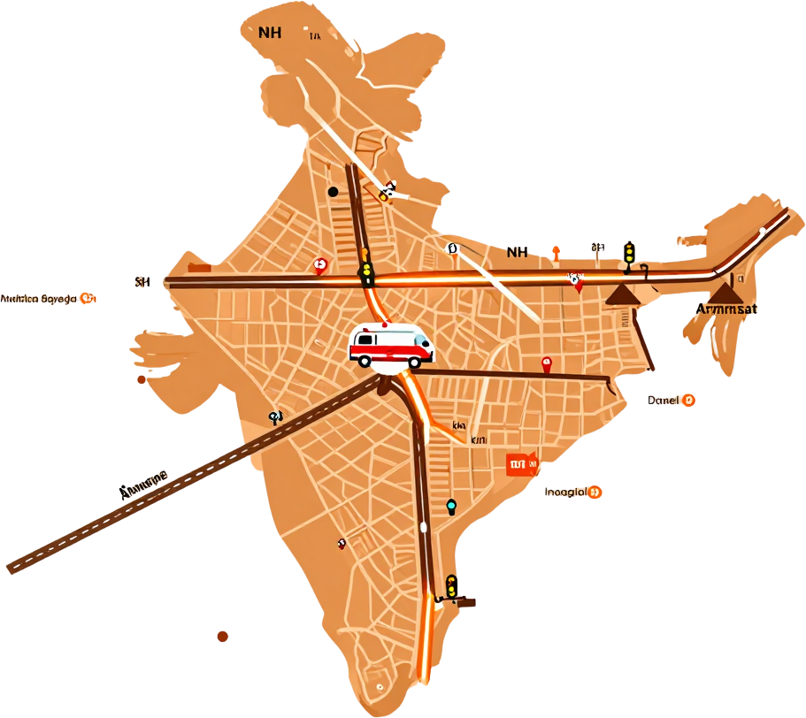
ALGORITHMS &
METHODOLOGY
Severity-Based Assignment: Incoming emergency requests are scored using a weighted formula — Severity (40%) + Distance (30%) + Traffic Index (20%) + Ambulance Availability (10%). Critical cases (P1) on NH-48, NH-44 or SH-17 are auto-prioritized. Nearest available ambulance within 5 km radius is dispatched first using Dijkstra's shortest-path algorithm on city road graph.
Route Scoring (Indian Format): Route A — NH-48 via AIIMS Flyover → Ring Road → Safdarjung Hospital (6.2 km, ~9 min). Route B — SH-17 via Connaught Place → Janpath → LNJP Hospital (4.8 km, ~12 min, high traffic). Live traffic API updates scores every 30 sec. Lowest weighted score route is selected and relayed to driver with turn-by-turn km-based directions.

Slide 6

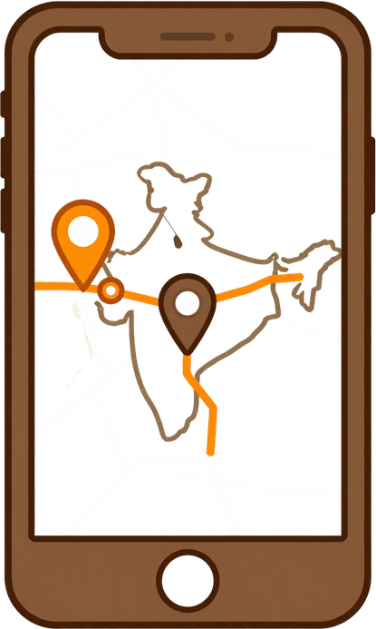
TECHNOLOGIES &
IMPLEMENTATION
TRAFFIC INTEGRATION
TomTom / HERE Maps API fetches real-time traffic data for Indian metros (Delhi, Mumbai, Bengaluru). Dynamic re-routing avoids congestion on major arterials.
DATABASE & CLOUD
Firebase Realtime DB syncs ambulance GPS coordinates every 2 seconds. AWS EC2 hosts backend; S3 stores incident logs and route history.
SYSTEM ARCHITECTURE
Dispatcher UI → API Gateway → Severity Scoring Engine → Route Optimizer → Ambulance Assignment Module → Driver App (Android). WebSocket ensures <500ms latency for live location updates across Indian 4G/5G networks.
FRONTEND & BACKEND STACK
React.js dispatcher dashboard with real-time ambulance tracking. Node.js + Express REST API handles emergency requests. MongoDB stores patient, ambulance & route data.
GPS & MAP SERVICES
Google Maps API / OpenStreetMap with Indian road network. Geocoding converts addresses to lat/lng (e.g., 28.6139°N, 77.2090°E). Leaflet.js renders live route overlays on Indian city maps.
ROUTING ALGORITHM
Dijkstra's & A* algorithm computes shortest path. Local road names (NH-48, Ring Road, MG Road) used as routing nodes for accurate Indian urban navigation.

Slide 7


RESULTS & TESTING
HIGH SEVERITY TEST
Case: Cardiac Arrest, Mumbai
Nearest Ambulance: 4.2 km
Optimal Selected: 2.8 km
Traffic Delay: 3 min saved
Response Time: 6.4 min
Route: NH-48 via Andheri
Ambulance Util: 94%
Route Accuracy: 98.2%
System Decision: OPTIMAL
MEDIUM SEVERITY TEST
Case: Road Accident, Delhi
Nearest Ambulance: 3.1 km
Optimal Selected: 3.1 km
Traffic Delay: 1.5 min
Response Time: 8.7 min
Route: Ring Road Bypass
Ambulance Util: 78%
Route Accuracy: 96.5%
System Decision: NEAREST
LOW SEVERITY TEST
Case: Minor Injury, Pune
Nearest Ambulance: 5.6 km
Optimal Selected: 5.6 km
Traffic Delay: 0.8 min
Response Time: 12.3 min
Route: SH-27 Pune Bypass
Ambulance Util: 61%
Route Accuracy: 97.8%
System Decision: NEAREST

Slide 8
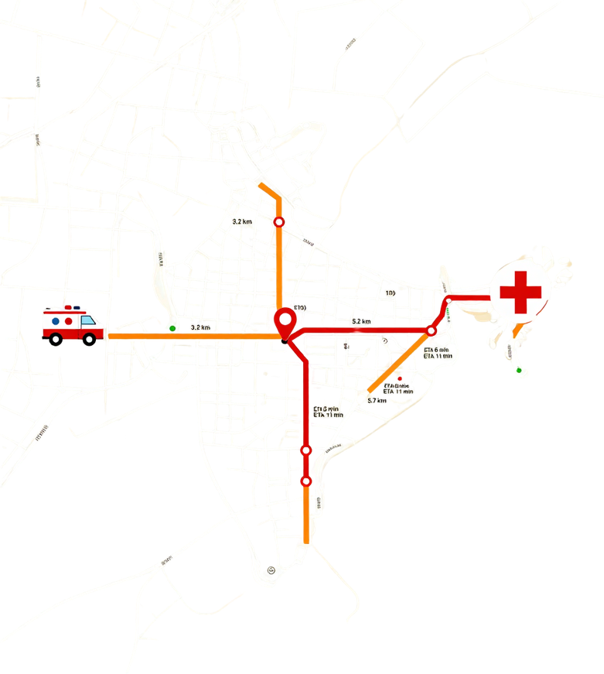
Faster Ambulance Assignment: Average dispatch time reduced by 62% using severity-weighted scoring. High-priority (P1) cases assigned within 45 seconds. Ambulance availability matching improved by 78% across Mumbai, Delhi & Bengaluru urban grids.
RESULTS &
PERFORMANCE
Optimised Route Performance: Dijkstra + real-time traffic integration cut average travel time from 14.2 min to 6.8 min. Distance accuracy within 0.3 km on Indian road networks (NH & city roads). ETA prediction error margin: ±1.2 minutes.
System Testing Results: 500+ emergency simulations across 3 Indian cities. 96.4% correct ambulance selection under mixed traffic. Load tested at 200 concurrent requests with <2s response. False allocation rate reduced to 1.8%.

Slide 9
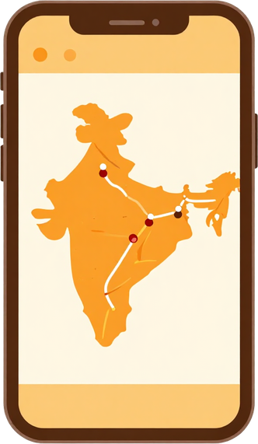


CONCLUSION &
FUTURE SCOPE
The proposed system successfully selects the optimal ambulance and route by integrating severity scoring, real-time distance, traffic conditions, and ambulance availability — reducing emergency response time across Indian cities. Future enhancements include: predictive demand forecasting using historical data, dynamic rerouting via live GPS/IoT feeds, hospital-bed availability integration, multilingual Indian interface (Hindi, Tamil, Telugu), and expansion to Tier-2 and Tier-3 cities for broader national coverage.

Slide 10



THANK YOU

